Slide 1


Grammatical messaging: Putin’s use of case
Laura A. Janda
Anna Obukhova
Tore Nesset
Václav Cvrček (Univerzita Karlova)
Masako Fidler (Brown University)
Threat-Defuser
(Norwegian Research Council)

Slide 2
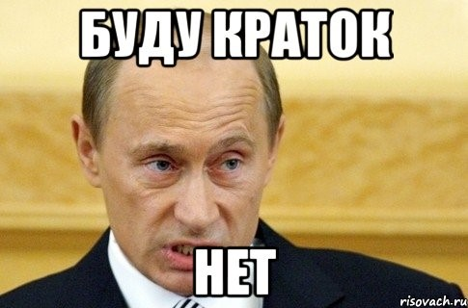
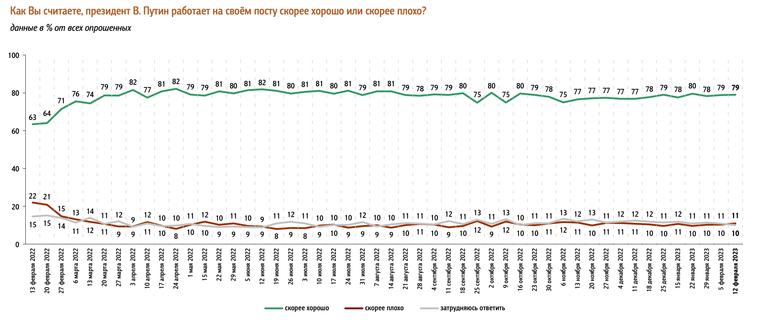
Why is Putin so popular?
Russians are usually skeptical of their government
Public opinion polls not entirely reliable, but a lot of people support Putin
Sociologists say people are “hypnotized”
Independent media shut down, replaced by 24-hour TV propaganda
Putin’s rhetoric
Data from:
Фонд Общественное Мнение
(Public Opinion Foundation)
“Do you think V. Putin is doing a good job or a bad job?”
(Feb 13 2022 – Feb 12 2023)

Slide 3
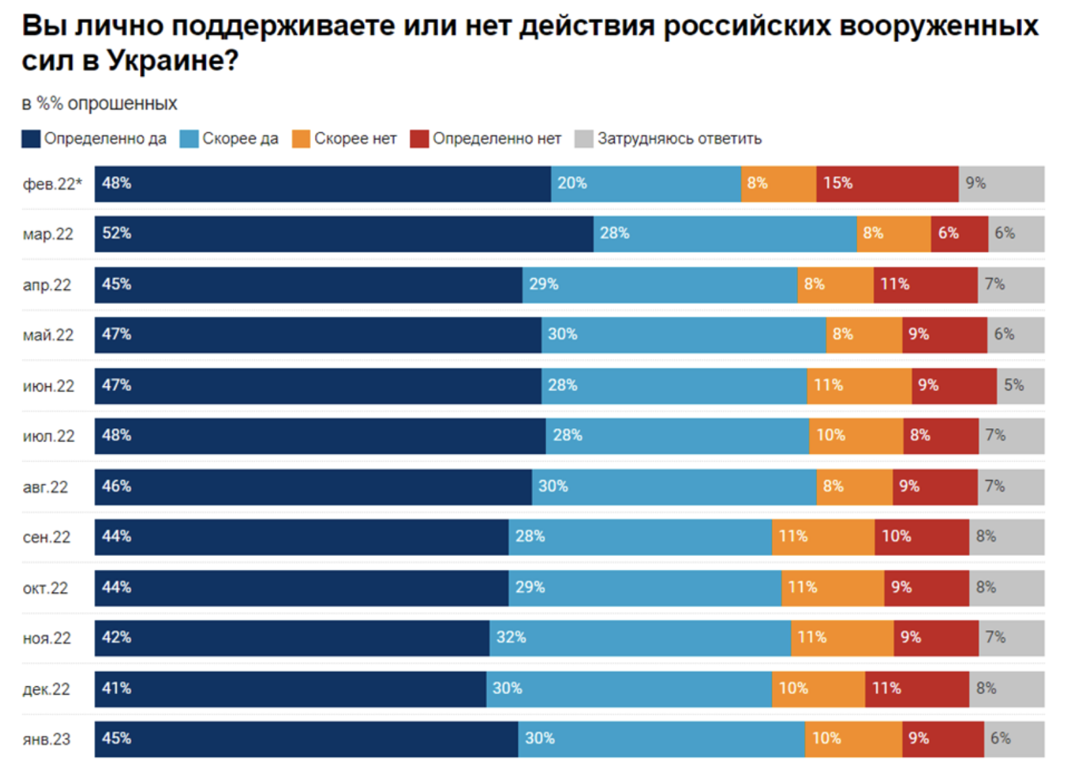
Do you support the Russian military operations in Ukraine?
Data from:
Levada Center
Definitely yes
Mostly
yes
Mostly
no
Definitely no
Jan 2023

Slide 4
Philosophical questions: words and grammar
A corpus as a proxy for the experience and expectations of a native speaker
Words can be consciously chosen, grammar less under conscious control and more systematic
Grammar and meaning: the semantic continuum lexicon – grammar

Slide 5
Overview
Keymorph Analysis as an extension of Keyword Analysis
Meanings of Russian grammatical cases
2022 “The case for case in Putin’s speeches” https://link.springer.com/article/10.1007/s11185-022-09269-2
Macro-level quantitative comparison: Putin’s use of case vs. reference corpus
Micro-level qualitative interpretation of Putin’s use of case
2023 Comparison with Putin’s speech Feb 21, 2023
Media have reported that this speech was more of the same
But we found some stark differences

Slide 6
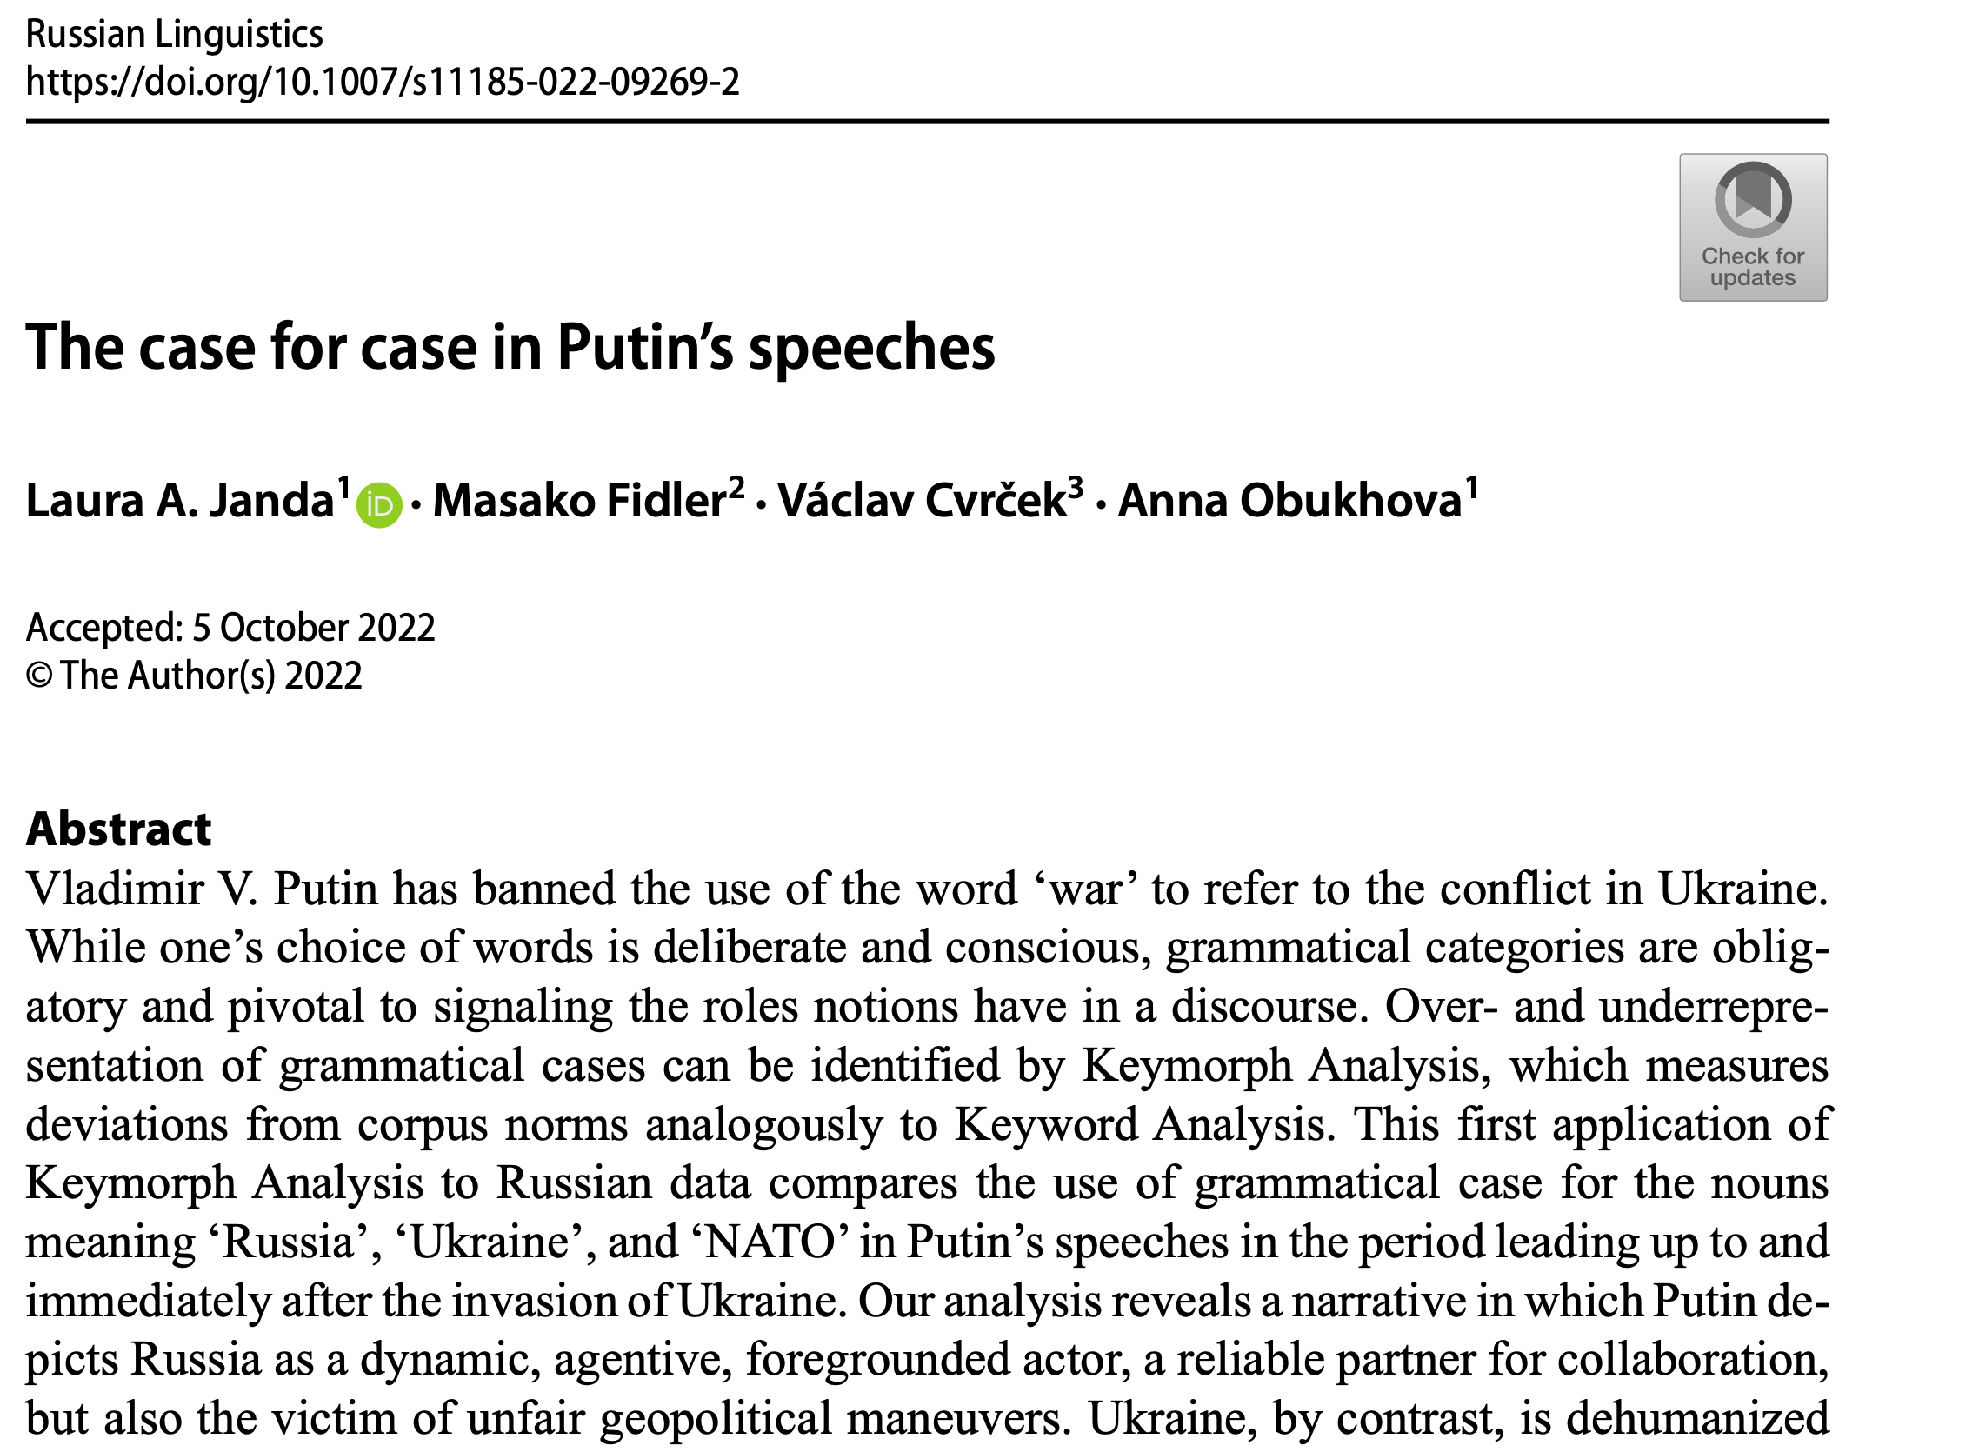
2022

Slide 7
Keymorph Analysis as an extension of Keyword Analysis
Keyword Analysis:
widely used in corpus-assisted discourse analysis
focus on the distribution of words, identifying as “keywords” those that are unusually frequent in a target text vs. reference corpus
Keywords reveal the “Aboutness” of a text
mostly used with English, which has little morphology
it is customary to remove English function words, also known as “stopwords”
Keymorph Analysis:
takes advantage of the morphological expression of grammatical categories
developed by Fidler & Cvrček (2017, 2018, and Cvrček & Fidler 2019) on the material of Czech
this is the first pilot study/proof-of-concept using Russian data

Slide 8
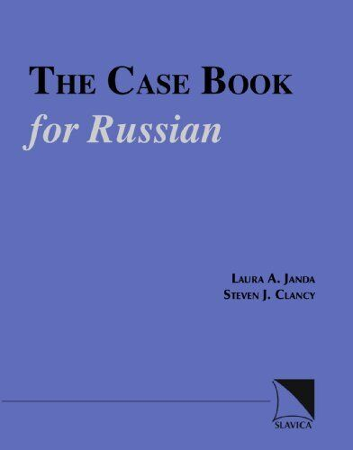
Meanings of Russian grammatical cases
Based on previous publications (Janda 1993, 1999, 2000, Janda & Clancy 2002 )
Meanings most relevant for analysis of Putin’s speeches in 2022
Nominative (NOM): agent (subject); label
Rossija.nom normalizovala svoju bjudžetnuju politiku ‘Russia.nom has normalized its budgetary policy’ (doc#12)
rasširenie bloka NATO.nom ‘expansion of the NATO.nom bloc’ (doc#23)
Genitive (GEN): agent or patient; possession
razvitie Rossii.gen ‘the development of Russia.gen’ (doc#17)
ispolʹzovanie Ukrainy.gen kak instrumenta protivostojanija s našej stranoj ‘use of Ukraine.gen as an instrument of opposition to our country’ (doc#16)
Dative (DAT): potential agent (usually human)
pojas družestvennyx Rossii.dat gosudarstv ‘zone of states friendly to Russia.dat’ (doc#17)
Accusative (ACC): patient (direct object); destination
obʺjavljajut nas, Rossiju.acc, svoim vragom ‘declare us, Russia.acc, their enemy’ (doc#23)
vstuplenie Ukrainy v NATO.acc ‘Ukraine’s entry into NATO.acc’ (doc#17)
Instrumental (s + INS): collaborator
sotrudničestvo s Rossiej.ins ‘collaboration with Russia.ins’ (doc#7)
Locative (LOC): a place
Xoču, čtoby èto ponjali i v Rossii.loc, i na Ukraine.loc ‘I want them to understand this, both in Russia.loc and in Ukraine.loc’ (doc#17).

Slide 9
Macro-level quantitative comparison: Putin’s use of case vs. reference corpus
Data: scope and source
Raw data
Difference Index keyed to frequency (DIN*)
Visualizations

Slide 10
Data: Putin’s speeches 10.02.-02.03.2022
10.02.2022: Russia launched its “largest military exercise since the Cold War, holding joint maneuvers with Belarus, close to the Belarus/Ukrainian border” (Walker 2022: 27).
02.03.2022: height of the first phase of invasion when Russian forces in Ukraine moved “to tighten their siege of key cities, including the capital, Kyiv, and the southern port of Mariupol” (Walker 2022: 39)
Size of target corpus: 34,720 tokens
Focus on three words:
Россия ‘Russia’
Украина ‘Ukraine’
НАТО ‘NATO’
Reference corpus:
Russian InterCorp (Czech National Corpus www.korpus.cz) 20.1 M tokens

Slide 11
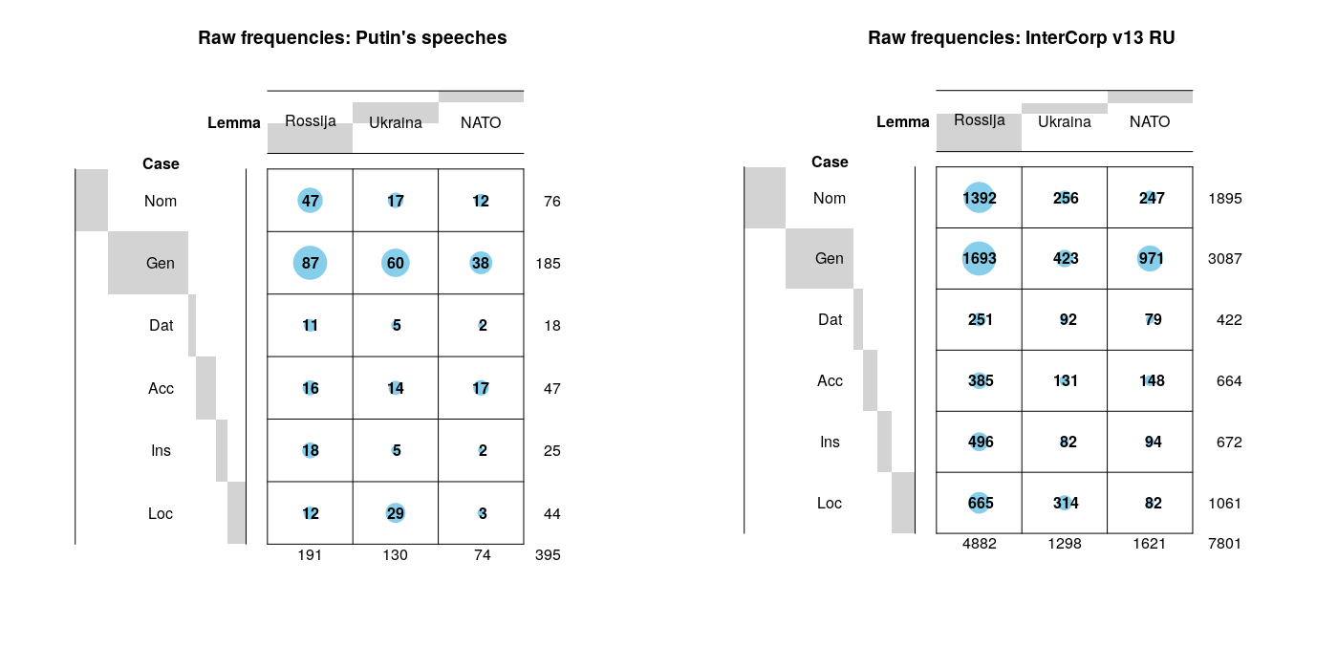

Slide 12
DIN* (difference index adjusted for frequency)
Case | DIN*(Rossija) | DIN*(Ukraina) | DIN*(NATO)
NOM | -7.352 | -20.262 | 3.112
GEN | 13.551 | 17.227 | -7.685
DAT | 5.668 | -29.648 | -28.653
ACC | 3.018 | 3.244 | 43.120
INS | -3.757 | -24.315 | -36.419
LOC | -36.870 | -4.050 | -11.024
DIN* uses relative frequencies to represent the proportion of a given inflected wordform in relation to all occurrences of the lemma in the target text and reference corpus respectively

Slide 13
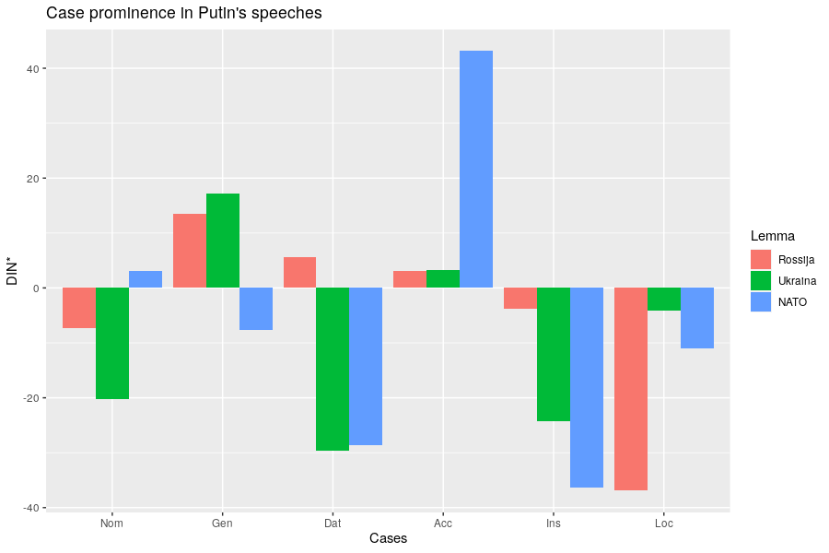
Comparison with reference corpus
2022
MORE than in corpus
SAME as in corpus
LESS
than in corpus

Slide 14
Micro-level qualitative interpretation of Putin’s use of case
Representation of
NATO
Ukraine
Russia
Every example manually tagged for case submeaning

Slide 15

NATO in 2022
NATO represented as
just a label, not an agent (NOM)
a threat (GEN)
a destination or container (ACC, LOC)
not a collaborator, dehumanized (little INS and DAT)

Slide 16

Ukraine in 2022
Ukraine represented as
passive (NOM with stative verbs)
manipulated (ACC)
dehumanized (little DAT)
not a collaborator (little s + INS)
just a location, a region (na + LOC, GEN)

Slide 17
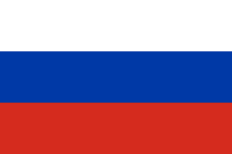
Russia in 2022
Russia represented as
a dynamic agent (NOM)
a collaborator (INS)
treated unfairly (ACC) and therefore in need of a strong leader
humanized, inspires empathy (DAT)

Slide 18
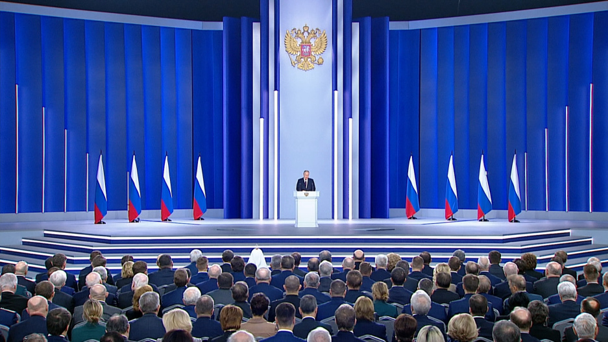
Putin’s speech to the Federal Assembly Feb 21, 2023: 10,538 tokens

Slide 19
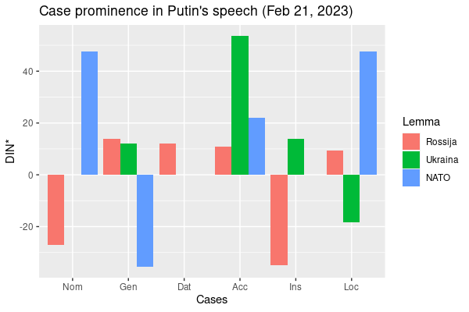
2022
Caveat: some distortion due to much smaller dataset
No data for
‘Ukraine’ Nominative, Dative
‘NATO’ Dative, Instrumental

Slide 20
NATO in 2023
NATO represented as
an aggressor, placing weapons on Russia’s borders, directly stating that it wishes to defeat Russia, equated with USA and the West (NOM)
having expanded to Russia’s borders and having representatives who are liars and deceivers (GEN, ACC)
the location of multiple nuclear arsenals (LOC)
strongly dehumanized (no s + INS, no DAT)

Slide 21
Ukraine in 2023
Ukraine represented as
non-existent as an actor (no NOM)
entirely manipulated, the destination of NATO’s weapons (ACC, na)
dehumanized (no DAT)
not a collaborator (no s + INS), just today’s name for a place (INS)
the location of a conflict and a neonazi regime (na + LOC)

Slide 22
‘Ukraine’ appears only 12 times in 2023 speech:
Мы не воюем с народом Украины...
‘We are not fighting with the people of Ukraine (GEN)...’
А в наше время из Украины они стали делать <<анти-Россию>>.
‘At present they have started to make Ukraine (GEN) into an “Anti-Russia”’
этот проект ... с одной целью - оторвать эти исторические территории, которые сегодня называются Украиной , от нашей страны.
‘this project ... [has] one goal – to tear away from our country the historical territories that are now called Ukraine (INS)’
Запад использует Украину и как таран против России, и как полигон.
‘The West is using Ukraine (ACC) both as a battering ram against Russia, and as an artillery range.’

Slide 23
Russia in 2023
Russia represented as
an agent that helps others, remembers, depends on its citizens, an open country (NOM)
a land of great potential and people, unfairly targeted (GEN)
united (s + INS)
being exploited but cannot be defeated, the place to invest (ACC)
humanized and victimized, in no need of cooperation with western economies (DAT)
a place with a strong economy and values (LOC)

Slide 24
Putin 2022 vs. Putin 2023: What has changed?
NATO
no longer the destination of Ukraine
foregrounded as the aggressor
Ukraine
sinks further into background
Russia’s “historical territories”, the West’s “Anti-Russia”
Russia
self-sufficient economy with great potential
unfairly targeted by the West

Slide 25
What does this buy us?
Proof-of-concept for Keymorph Analysis applied to Russian data
Keymorph Analysis can complement Keyword Analysis and other traditional methods of discourse analysis
Analysis of grammatical case reveals roles of social actors in discourse
Consistent deviation from norms likely has an impact on hearers
Useful not only for linguistics, but for history, political science, and other disciplines in the social sciences
Invites further comparisons (Putin vs. other politicians, etc.)

Slide 26

Threat-Defuser: Other methods and results
Market Basket Analysis (Czech News Media; Russian media about Svalbard)
“Threat”: corpus analysis of words and constructions
Media Search Engine (for Norwegian media; version for Russia under development)
See: https://threat-defuser.org/
Funded by the Norwegian Research Council

Slide 27
CLEAR group: Research-based teaching resources
Strategic Mastery of Russian Tool: SMARTool
https://smartool.github.io/smartool-rus-eng/
Russian Constructicon
https://constructicon.github.io/russian/
Min russiske reise / My Russian Journey
https://mooc.uit.no/courses/course-v1:UiT+C001+2020/about

